Slide 1

Fitness Center Analysis
Faculty Sponsor: Prof. Dr. Jiangping Wang, Ph.D.
Presented by: Hemanth Matta
Department of Computer and Information Sciences

Slide 2
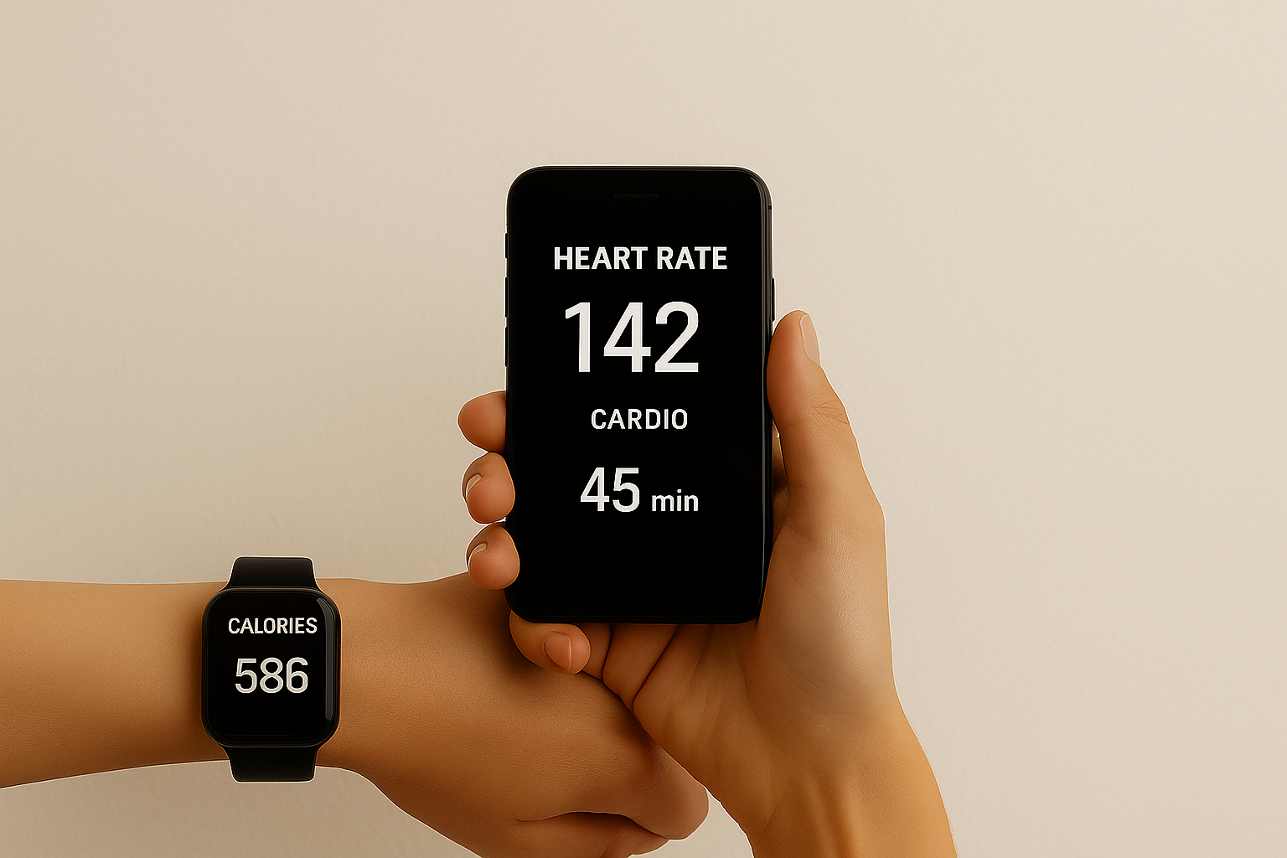
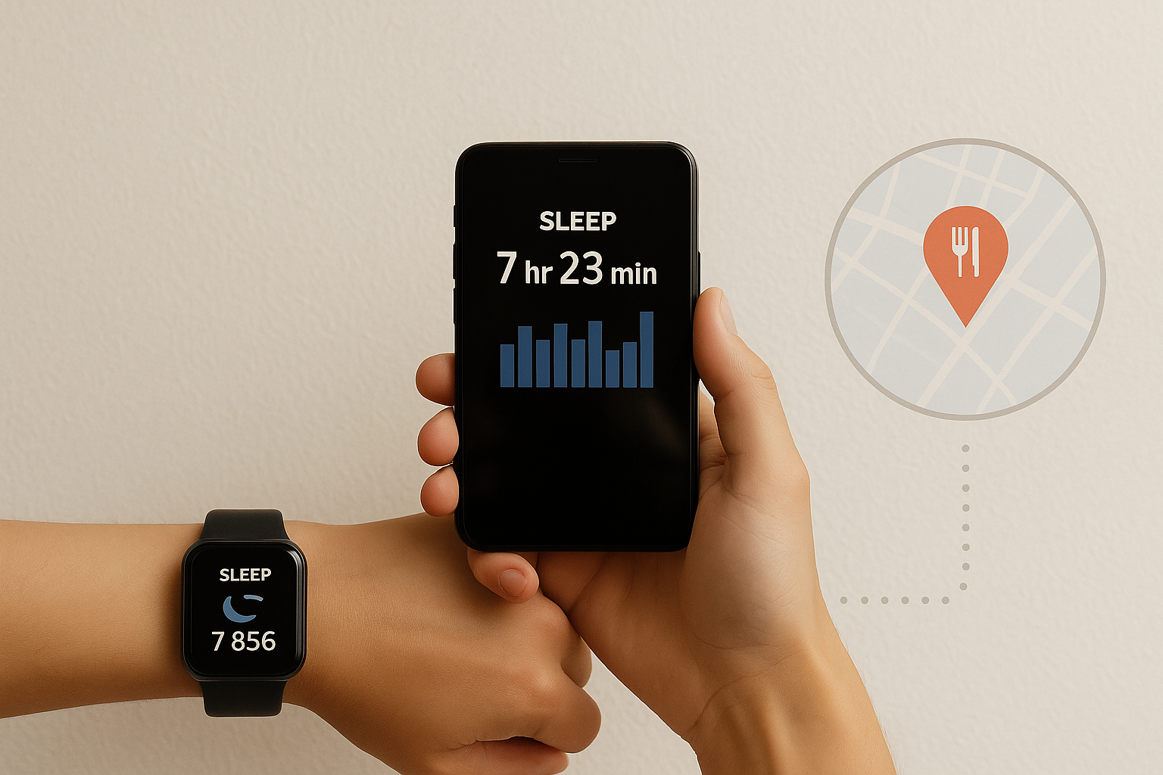
The Power of Everyday Data
Every action we take creates data:
Apple Watch tracking your steps
Your phone recording your sleep
Restaurant visits through Google Maps
Businesses can use this hidden data to understand customers better.

Slide 3
The Power of Everyday Data
Every action we take creates data: Your heart rate throughout the session
How many calories you burned
The type and duration of your exercise
Businesses can use this hidden data to understand customers better.

Slide 4
Collected detailed data from hundreds of members
Data included workout habits, health stats, and engagement
Meet FitLife Wellness
Modern fitness center with large facilities and equipment
Wanted to use this data to better understand customers

Slide 5
Meet FitLife Wellness
2. Collected detailed data from hundreds of members
3. Data included workout habits, health stats, and engagement
1. Modern fitness center with large facilities and equipment
4. Wanted to use this data to better understand customers
2
1
3
4

Slide 6


Business Problem:
Generic workout programs for all members
No personalization based on fitness level
Low engagement and customer satisfaction
Business Goal:
Understand different member types
Create personalized workout plans
Increase engagement and customer loyalty

Slide 8






Data Cleaning
Feature Engineering
Variable Selection
Model Building
Model Validation
Business Strategy
DATA ANALYTICAL APPROACH

Slide 9
Data Cleaning
Feature Engineering
Variable Selection
Model Building
Model Validation
Business Strategy

Slide 10
WHAT DATA FITLIFE COLLECTED
Data Contains
Age, Gender, Weight, Height
Workout Type and Duration
Calories Burned and Fat Percentage
Water Intake and Workout Frequency
Experience Level (Beginner, Intermediate, Advanced)BMI (Body Mass Index)
Heart Rates: Max BPM, Avg BPM, Resting BPM

Slide 11
WHAT DATA FITLIFE COLLECTED
Data Contains
Age, Gender, Weight, Height
Workout Type and Duration
Calories Burned and Fat Percentage
Water Intake and Workout Frequency
Experience Level (Beginner, Intermediate, Advanced)BMI (Body Mass Index)
Heart Rates: Max BPM, Avg BPM, Resting BPM
Data collected from 970 fitness center members

Slide 12
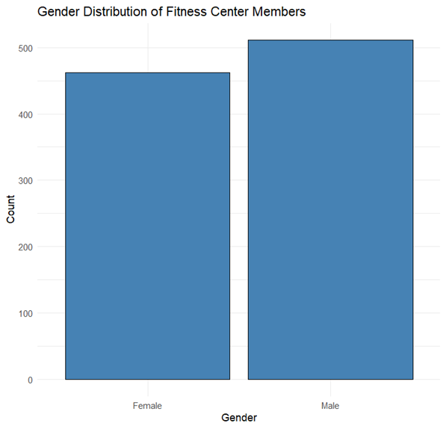
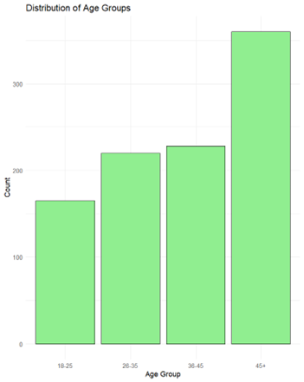
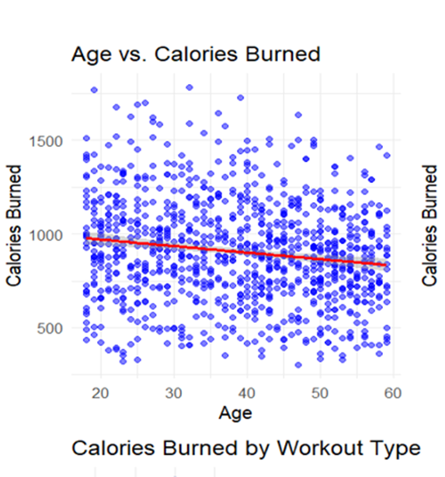
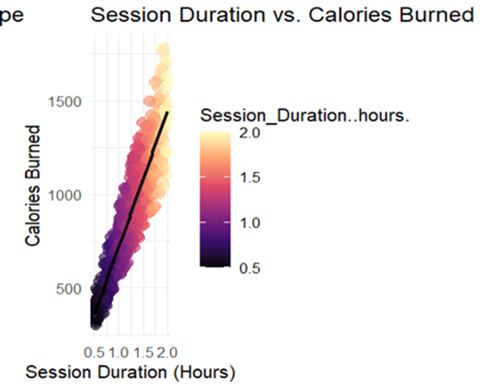
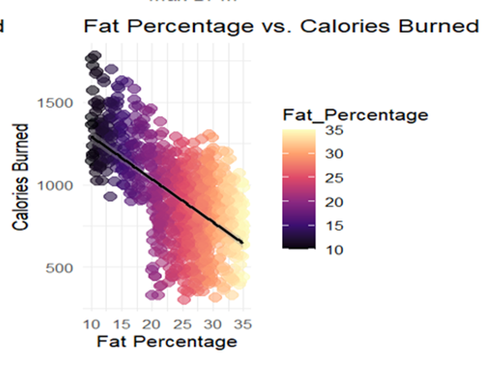
DATA EXPLORATION

Slide 13
ENHANCING THE DATA FOR BETTER SEGMENTATION
Created smarter fitness features:
Workout Intensity Score
Hydration Need Ratio
Heart Rate Range
Helped capture deeper workout behaviors

Slide 14
WHAT IS MEMBER SEGMENTATION?
Grouping members based on similar fitness behavior and health patterns
Helps understand different types of customers
Each group can be served with customized workout plans
Key to better engagement and satisfaction

Slide 15
HOW MEMBERS WERE GROUPED
Selected most meaningful fitness features for grouping
Applied two clustering methods:
K-Means Clustering
Tested different numbers of groups (2 to 6)Found 3 clusters gave the best and most meaningful separation

Slide 16
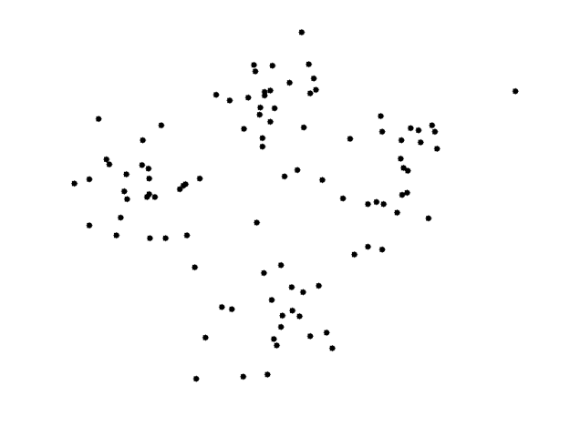

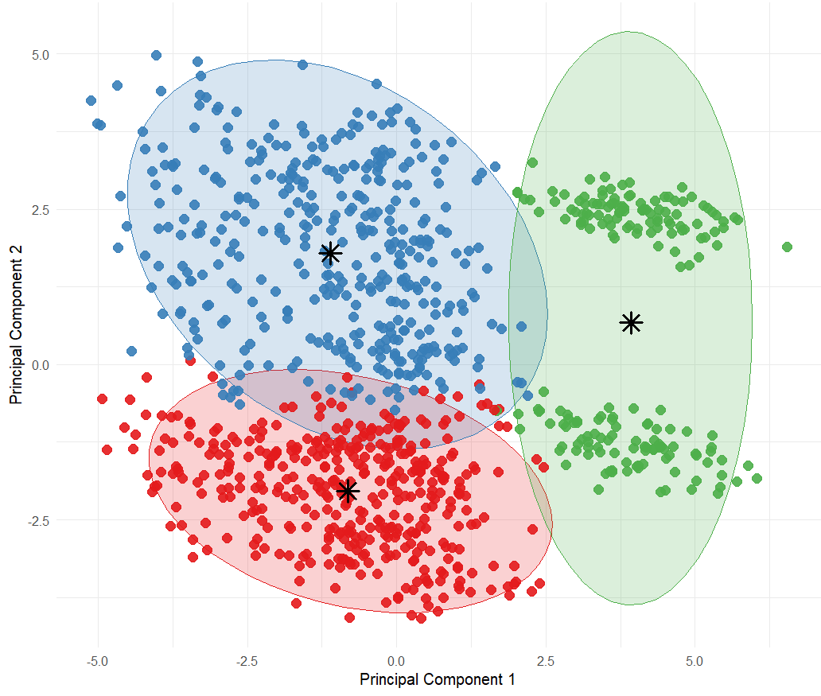
K-MEANS CLUSTERING

Slide 17
DISCOVERING THE 3 MEMBER SEGMENTS
Cluster 01
Cluster 02
Cluster 03
Experienced & Intense Members
High-intensity workouts (Strength, HIIT), strong heart metrics
Active & Hydrated Members
Consistent workouts, good hydration, balanced health
Beginner Members
Shorter workouts, higher BMI, need more guidance

Slide 18
DISCOVERING THE 3 MEMBER SEGMENTS
Cluster 01
Cluster 02
Cluster 03
Experienced & Intense Members
High-intensity workouts (Strength, HIIT), strong heart metrics
Active & Hydrated Members
Consistent workouts, good hydration, balanced health
Beginner Members
Shorter workouts, higher BMI, need more guidance

Slide 19
DISCOVERING THE 3 MEMBER SEGMENTS
Cluster 01
Cluster 02
Cluster 03
Experienced & Intense Members
High-intensity workouts (Strength, HIIT), strong heart metrics
Active & Hydrated Members
Consistent workouts, good hydration, balanced health
Beginner Members
Shorter workouts, higher BMI, need more guidance

Slide 20



ACTION PLAN
cluster
1
Offer endurance challenges (e.g., long-distance events)
Introduce advanced cardio and strength combination workouts
Build loyalty programs to maintain motivation
cluster
2
3
cluster
Offer beginner-friendly training programs
Provide basic health education (hydration, nutrition)
Assign personal coaching for motivation and tracking progress
Provide performance-driven programs (e.g., strength competitions)
Offer personal best tracking and progress dashboards
Create elite fitness groups or leadership programs

Slide 21
ACTION PLAN
cluster
cluster
1
2
Offer endurance challenges (e.g., long-distance events)
Introduce advanced cardio and strength combination workouts
Build loyalty programs to maintain motivation
Offer beginner-friendly training programs
Provide basic health education (hydration, nutrition)
Assign personal coaching for motivation and tracking progress
cluster
3
Provide performance-driven programs (e.g., strength competitions)
Offer personal best tracking and progress dashboards
Create elite fitness groups or leadership programs

Slide 22
ACTION PLAN
cluster
cluster
cluster
1
2
3
Offer endurance challenges (e.g., long-distance events)
Introduce advanced cardio and strength combination workouts
Build loyalty programs to maintain motivation
Offer beginner-friendly training programs
Provide basic health education (hydration, nutrition)
Assign personal coaching for motivation and tracking progress
Provide performance-driven programs (e.g., strength competitions)
Offer personal best tracking and progress dashboards
Create elite fitness groups or leadership programs

Slide 23
Predict calorie burn for each workout
Predict member dropout risk
WHAT MORE WE CAN DO WITH DATA
Advise on hydration and nutrition
Send personalized motivational messages based on member progress
Create targeted marketing campaigns

Slide 24
Final Thoughts – Data → Action
Data alone is not enough
The real power lies in extracting insights
Turning insights into real-world actions
Personalization leads to better engagement and loyalty
Data analytics drives smarter business decisions

